Slide 1
Investing Basics
Asset Allocation And Portfolio Selection

Slide 2
Intelligent Investing is a Two-Step Process
Step 1: Asset Allocation—the allocation of funds across different asset categories—cash, stocks, bonds, commodities, etc.

Slide 3
Sep 2:
Portfolio selection
The choice of individual assets within each category.

Slide 4
Top Down versus Bottom up approach to investing
Some begin with step 1
That’s a “top down approach”
Others begin with step 2. That’s a “bottom up approach”

Slide 5
Asset Allocation Begins with:
The personal profile of each individual
Younger individuals should have a bias for stocks, as stocks usually outperform other investors over the long-term.
Older individuals should have a bias for bonds and cash, especially individuals near or at retirement
Bonds pay income in the form of coupons, which can supplement income.
Cash offers safety of principal and liquidity.

Slide 6
Asset Allocation Continues with
The ”Macro-picture”
--An evaluation of the prospects for economic growth and interest rates
--An evaluation of country demographics

Slide 7
How Prospects Of Economic Growth Affect: Bonds
A stronger economy is usually (when driven by higher demand) associated with higher inflation and higher interest rates while a weaker economy is associated with lower inflation and lower interest rates
Higher interest rates are bad for bonds
They drive bond prices lower and yields higher
Lower interest rates are good for bonds
They drive bond prices higher and yields lower
Economic booms are the worst for bonds
Recessions and depressions are best for high quality (e.g., US Treasury) bonds

Slide 8
How Prospects Of Economic Growth Affect: Stocks
The relationship between stocks and economic growth is tricky
On the one side, higher growth drives corporate revenues and earnings higher
That’s good for stocks
On the other side, higher growth drives interest rates higher.
That’s negative for stocks

Slide 9
Which of the two effects prevails?
It depends on the state of the economy when the investment decision is made.
If the investment decision is made in the middle of a recession, and the economy improves, corporate revenues rise quickly, while interest rates rise slowly.
That’s the best time to buy stocks.

Slide 10
Which of the two effects prevails? (Continued)
Conversely, if the investment decision is made in the middle of an economic boom, and the economy is about to turn, corporate revenues rise slowly, while interest rates rise fast.
That’s the worst time to buy stocks

Slide 11
Which Of The Two Effects Prevail? (continued)
The impact of economic growth on interest rates also depends on the sources of growth
Demand driven growth fuels inflation and higher interest rates
That’s bad for stocks
Supply driven growth is associated with lower inflation and lower interest rates
That’s good for stocks

Slide 12
How Prospects Of Economic Growth Affect: Commodities
The relationship between economic growth and commodities is tricky, too
On the one side, a strong economy is good for commodities, as stronger growth generates more demand for commodities
On the other side, a stronger economy drives the US dollar higher, and that’s bad for commodities (commodities tat are quoted in US dollars, like oil and precious metals).

Slide 13
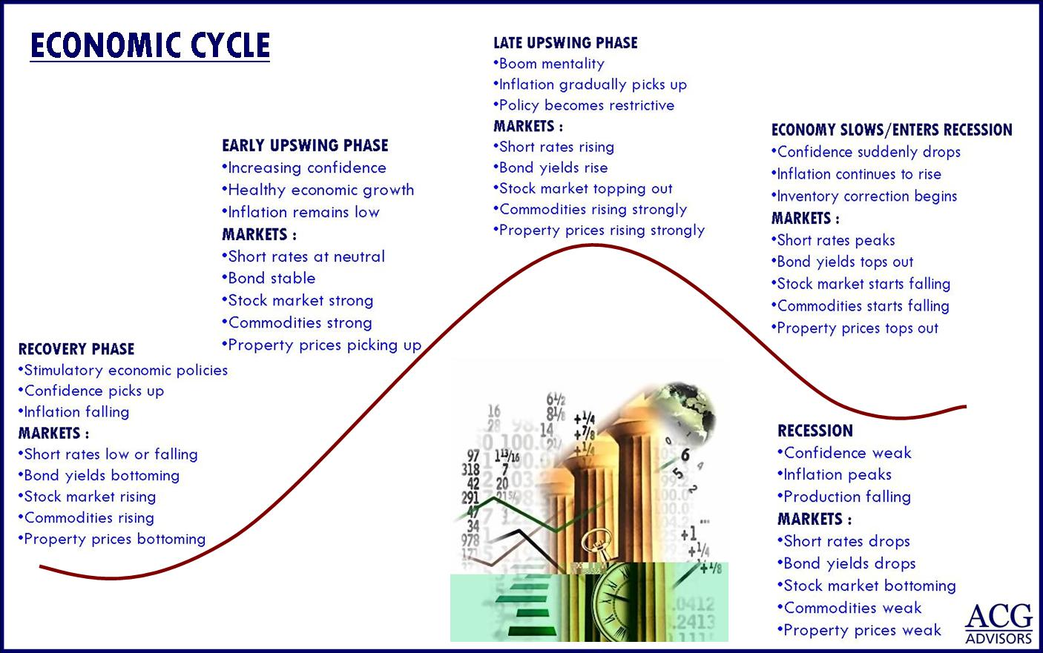

Slide 14
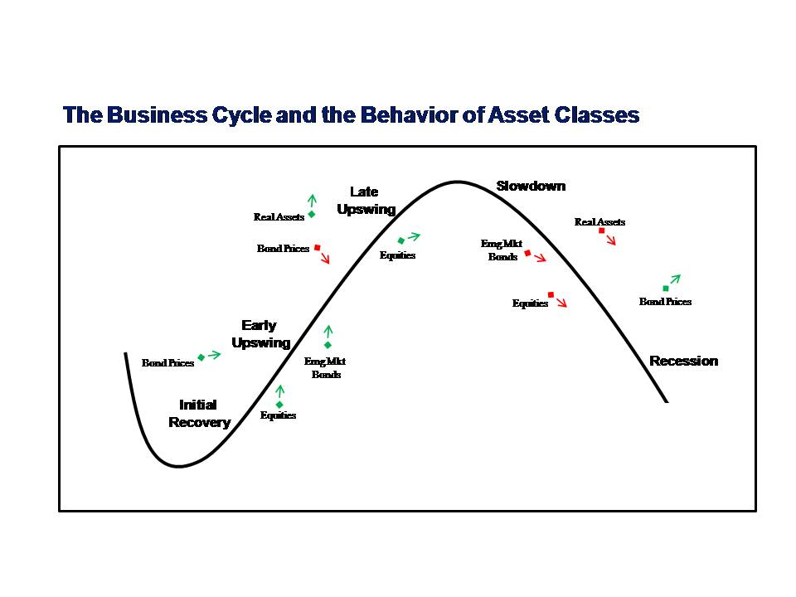
https://iharborcap.wordpress.com/

Slide 15
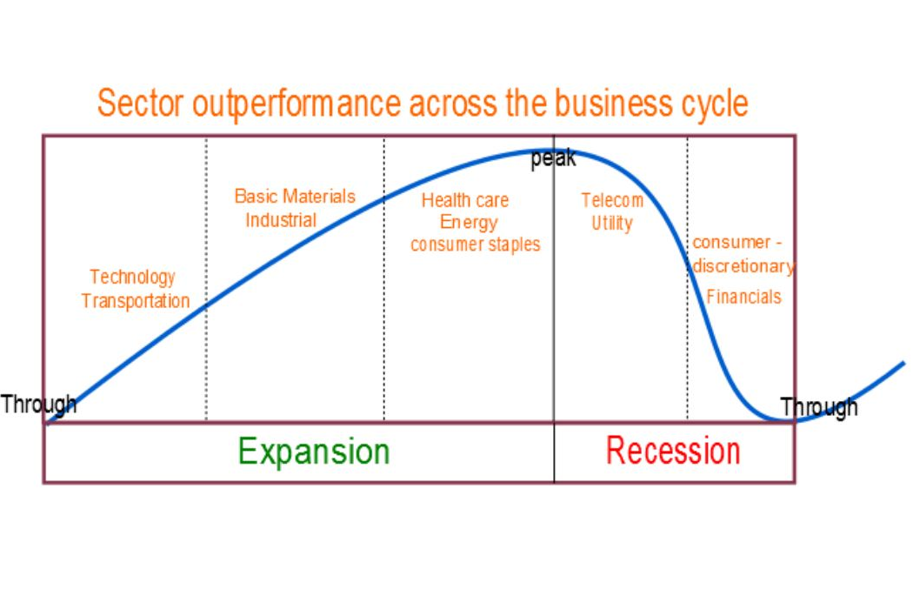
http://www.alphaassetallocation.com/sector-rotation-model/

Slide 16
How Demographics Affect Asset Allocation
A “normal” population pyramid is good for economic growth, capital, and consumer spending
That’s bullish for stocks
A “normal” population pyramid creates positive demographic dividends by lowering the “dependency” rate, many workers support a few retires
That’s bullish for bonds as it doesn’t require government borrowing to pay for pensions

Slide 17
How Demographics Affect Asset Allocation (continued)
An abnormal demographic pyramid is bad for economic growth and consumer spending, and therefore, bearish for stocks
An Abnormal demographic pyramid creates negative demographic dividends, too few workers support too many retirees.
The government must borrow money to pay for pensions, and that’s bearish for bonds

Slide 18
Nigeria’s ”Normal Population Pyramid

Slide 19
Bangladesh “Normal” Population Pyramid

Slide 20
China’s ”Abnormal” Population Pyramid

Slide 21
In sum:
Asset allocation begins with the personal profile of the customer
Takes into consideration the macroeconomic conditions
And the demographic trends

Slide 22
Asset Allocation In Emerging Markets
Look for countries with improving macroeconomic fundamentals
And a “normal” population pyramid--a pyramid with a young population at its base.
A youthful population attracts foreign investments, which fuels growth
Higher growth creates a middle class that fuels consumer spending in discretionary items

Slide 23
Portfolio selection depends on the expected profitability of different companies
I usually begin the Peter Lynch way—with a list of companies that I’m familiar with.
Then, I proceed with the Benjamin Graham/Warren Buffet Way--I look at the business model and business strategy of each company; and connect business strategy with investment strategy.

Slide 24
From Business Strategy To Investment Strategy: How To Pick Up Winning Stocks
Look for companies with Superior Business Strategy

Slide 25
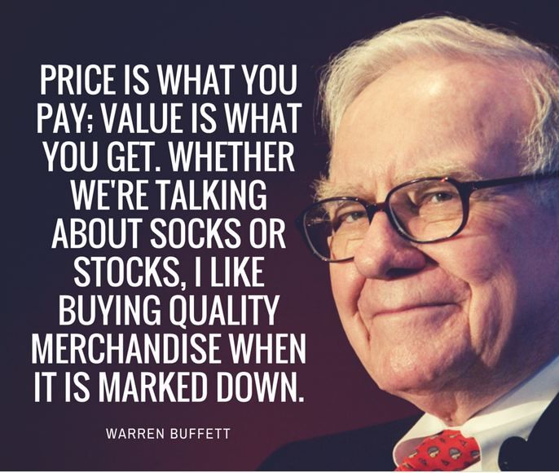

Slide 26

Dodd & Graham

Slide 27
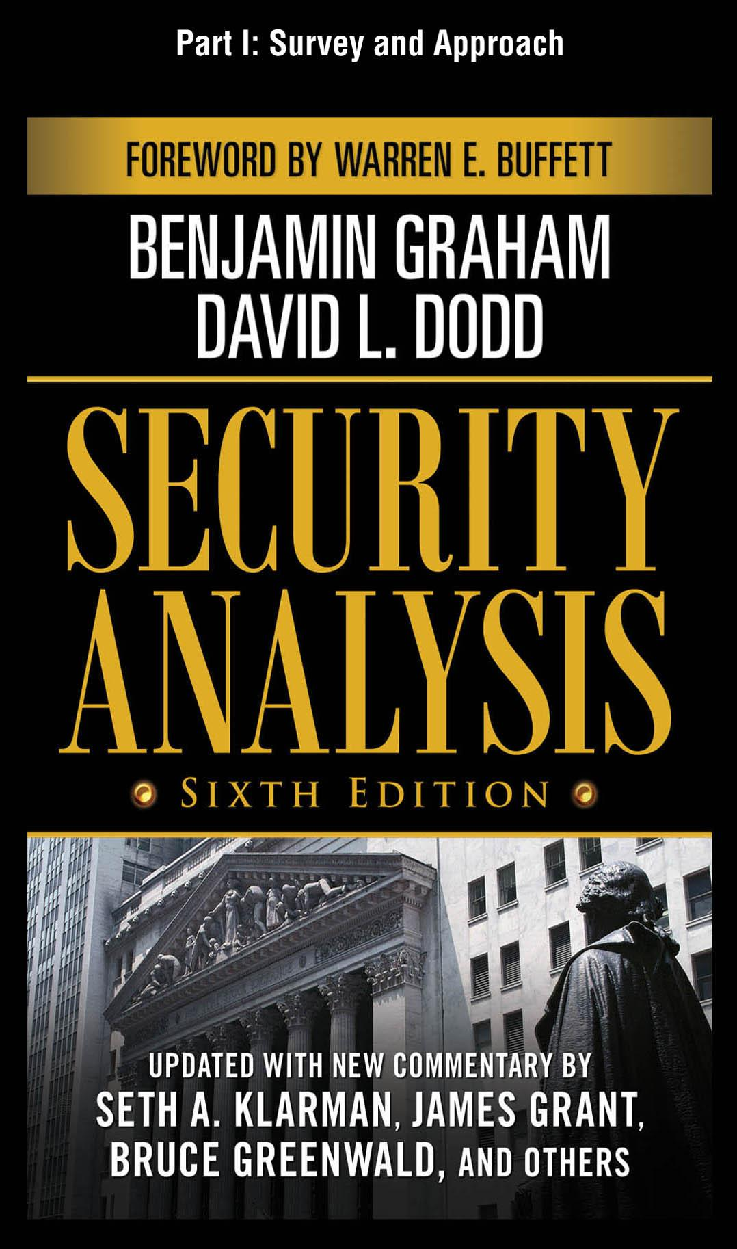
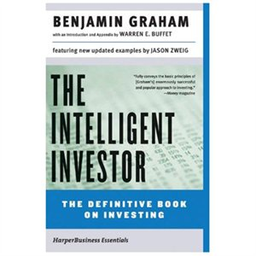
Graham: Father of Value Investing

Slide 28
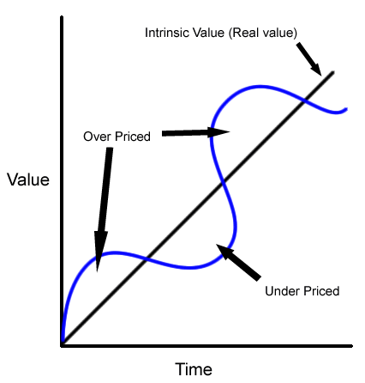
Intrinsic Value vs. Market Value

Slide 29

Fundamental Analysis
Evaluating a security in an attempt to measure its intrinsic value, by examining related economic, financial and other qualitative and quantitative factors.

Slide 30
“Benjamin Graham Formula”
Intrinsic Value = EPS x (8.5 + 2g)
P/E=8.5 x 2G
EPS = Diluted Earnings Per Share 8.5 = Fair /Ea Ratio for No-Growth Company G = Conservative EPS 7-10 year est. growth

Slide 31
Earnings Over Which Period?
Trailing 12 Months (ttm)
(past 4 quarters)
Forward
(Consensus Forecast – Current Year)

Slide 32
Price Earnings Growth PEG Ratio
P/E divided by 5-yr. growth rate
20 P/E with 25% forecasted growth
20/25 = 0.80
PEG < 1.0 Is What You Want

Slide 33
Price-Sales Ratio
Stock Price /
Sales Per Share
-More Stable Than Earnings
-Compare to industry group/sector
-Compare to company’s historical P/S ratio

Slide 34
Weighted Average Cost Of Capital - WACC
WACC is a calculation of a firm's cost of capital in which each category of capital is proportionately weighted.
Source: https://www.investopedia.com/terms/w/wacc.asp#ixzz5ECu9Lxs2

Slide 35
Return On Equity - ROE
Return on equity (ROE) is the amount of net income returned as a percentage of shareholders equity.
Return on equity measures a corporation's profitability by revealing how much profit a company generates with the money shareholders have invested.
Source: https://www.investopedia.com/terms/r/returnonequity.asp#ixzz5ECvTOWpy

Slide 36
What is a Superior Strategy?
A Strategy that leads a company to a
Sustainable Competitive Advantage.
A company has a sustainable competitive advantage if it enjoys above average profits for a long period of time.
Competitive Advantage = Above Average Profits
Sustainable = For a Long Period
Notice that this is an ex-post assessment of strategy.

Slide 37
How To Identify Companies With Above Above Average Profit
Profit Margins
Operating Margins
Revenue Growth
Markets Shares

Slide 38
How Do You Know Whether Profit Margins Are Sustainable?
Strengths
Weaknesses
Opportunities
Threats

Slide 39
Usual Strengths—Sources of Competitive Advantage
Leadership and Management
Economies of Scale and Scope
Economies of Networking
Branding
Franchising
Bundling
Innovation

Slide 40
Usual Weakness
Too much dependence on a few major customers
Too much dependent on a few suppliers
Too sensitive to business cycles
Too sensitive to political environment

Slide 41
Opportunities
New markets
New Ways of Distribution
New Products
New Business Models

Slide 42
Usual Threats
Imitation
Alternative products
Market Saturation

Slide 43
Companies with sustainable competitive advantage
Wal-Mart
P&G
Boeing
McDonald’s
Qualcomm
Diageo
Anheuser-Busch InBev

Slide 44
How To Look For Bargains In Emerging Markets
Follow Benjamin Graham and Warren Buffet
Look at Intrinsic Value versus Market value
Buy companies with strong balance sheet selling at half their cash value
Check case studies in Chapter 6 of the Frontier Investor

